Slide 1

Security Posture and Risk Assessment for Dallong-Opadotun & Co.
Using NIST framework and NDPR 2023

Slide 2

INTRODUCTION AND BACKROUND
Why does client confidentiality and data protection matter?
Client confidentiality and data protection matter because law firms handle sensitive information that must be protected from unauthorized access, disclosure, loss or misuse.
Common threats are: Phishing, Stolen devices and password theft.

Slide 3
1. Aim
The aim of this project is to assess and improve the security of personal devices used by employees to access the law firm's information, ensuring that confidential client data is protected from unauthorized access, theft and loss.
2. Objectives
Evaluate the existing security posture.
This involves examining the firm's current security practices, including password protection, device encryption, software updates, access controls and staff awareness, to determine how well its information is protected.
Identify and assess security risks.
This involves identifying threats such as password theft, phishing, lost devices, malware and unauthorized access. Each risk is assessed according to its likelihood and potential impact and classified as low, medium, high or critical.
Apply NIST CSF 2.0 and relevant NDPA 2023 requirements.
The NIST Cybersecurity Framework is used to assess and manage cybersecurity risks through its six functions: Govern, Identify, Protect, Detect, Respond and Recover. The Nigeria Data Protection Act (NDPA) 2023 is used to assess relevant personal-data protection and privacy obligations.
Recommend appropriate security controls and policies.
Based on the identified risks, recommend measures such as multi-factor authentication, device encryption, secure backups, mobile device management, staff training and a formal BYOD policy to improve the firm's security.

Slide 4
PRE-ASSESSMENT SURVEY
Device and password security. - Yes
Client data protection. - Yes
Phishing and staff awareness. - No
Access control. - No
Incident response and backups.- No
Policies and privacy compliance. - Yes

Slide 5
BYOD Security Audit Assessment Table {1-4} {Low-High}.
Questions asked | Clients answer | Risk level | NIST framework | Action required
Are personal devices encrypted and password-protected? | Yes | High | Protect (PR) | Enable full-disk encryption and automatic screen locks.
Are operating systems and applications regularly updated? | No | High | Protect (PR) | Enable automatic security updates and supported operating systems.
Is access to client files restricted to authorized employees? | Yes | High | Protect (PR) | Implement role-based access control and least privilege.
Are former employees' accounts disabled promptly? | No | High | Protect (PR) | Establish an employee offboarding and access-revocation procedure.

Slide 6
Are client files stored in approved and secure locations? | YES | High | Protect (PR) | Use access-controlled cloud storage and encryption.
Can the firm revoke access or remove work data when a device is lost? | NO | High | Respond (RS), Protect (PR) | Implement mobile device or application management (MDM/MAM).
Are security incidents reported and investigated? | NO | High | Detect (DE), Respond (RS) | Establish an incident response plan and reporting procedure.
Are client files backed up and recovery tested? | YES | High | Recover (RC) | Maintain protected backups and conduct restoration tests.
Does the firm have an approved BYOD and data protection policy? | NO | High | Govern (GV) | Develop BYOD, acceptable-use, access-control and data protection policies.

Slide 7
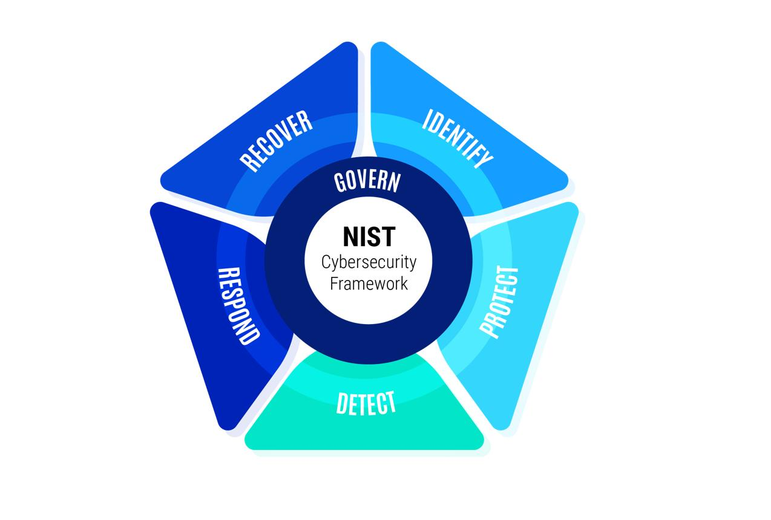
Govern Identify Protect Detect Respond Recover
NIST CSF 2.0 FRAMEWORK
Govern: Establish cybersecurity policies, responsibilities and rules
Identify: Safeguard systems and information using password, encryptions and access controls
Detect: Identify suspicious activities, cyberattacks and unauthorized access.
Respond: Take action to contain and manage security incidents
Recover: Restore systems and data after an incident and resume normal operations

Slide 8
SECURITY MEASURES
Address critical and high risks first.
Enforce MFA and device encryption.
Approve and communicate BYOD policies.
Train employees.
Review controls regularly.

